Slide 1
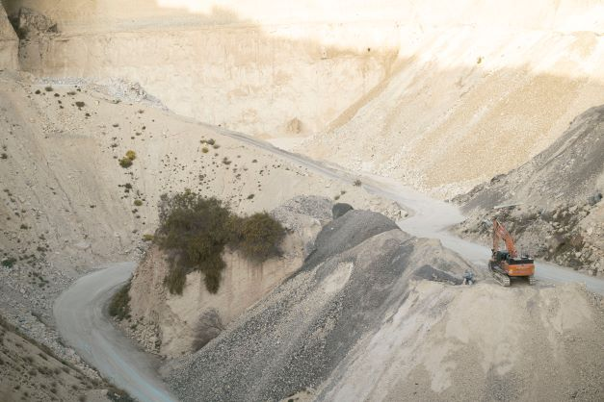
ENV 501 / GR A3 30
Exercise session 9 (interactive):
Spatial allocation of materials
Teaching assistant:
Jair Campfens jair.campfens@epfl.ch
Léonard Léchot leonard.lechot@epfl.ch
Fall 2025

Slide 2
2
Geographical Information System
Félix Martin del Campo, Campfens, Léchot
A Geographic Information System (GIS) is a computer-based tool that enables users to capture, store, manipulate, analyze, manage, and present spatial or geographic data.
GIS integrates spatial data with other datasets, providing powerful insights into patterns, relationships, and geographic trends that are critical for decision-making across multiple fields.

Slide 3
GIS in Material Flow Analysis
Félix Martin del Campo, Campfens, Léchot
Mapping Material Stocks and Flows
Spatial Allocation of Material Stocks
Temporal Analysis and Change Detection
Scenario Modeling for Circular Economy Goals
Integration with Socio-Economic Data
Notes:
Mapping Material Stocks and Flows: GIS enables the visualization of material stocks (like buildings, infrastructure, etc.) across different regions, highlighting areas of high and low accumulation. This spatial mapping is essential for understanding regional material densities and resource distributions, crucial in MFA.
Spatial Allocation of Material Stocks: GIS allows for the precise allocation of materials across specific locations (e.g., urban vs. rural areas), supporting insights into where resources are most intensively used. This helps identify “hotspots” of material consumption and stock, which is critical for urban mining, resource conservation, and regional planning.
Temporal Analysis and Change Detection: When paired with time-series data, GIS can show changes in material stocks over time. This feature is particularly useful for tracking construction growth, depletion of natural resources, and infrastructure expansion, providing a clearer picture of material flows in different locations.
Scenario Modeling for Circular Economy Goals: GIS supports scenario analyses, allowing researchers to predict the effects of interventions (like increased recycling or construction reduction) on material flows. This is useful in testing the impacts of policy measures aimed at increasing circularity within specific regions.
Integration with Socio-Economic Data: By linking spatial data with demographic, economic, or consumption patterns, GIS enhances the understanding of how factors like population density, economic development, or urbanization drive material accumulation. This helps develop more targeted, data-driven strategies for sustainable resource use.

Slide 4
Exercise: Spatial allocation of materials (Bottom-up Residential buildings)
Félix Martin del Campo, Campfens, Léchot
Downloading free GIS software – QGIS. Follow this link: https://qgis.org/download/
Click Download – Latest version
Once downloaded, open the file and install
Run QGIS
Download datasets from moodle (zip files)
Decompress and load the *.shp files into QGIS
  Identify the type of geometry (point, line, polygon)
Estimate the material quantities based on the information provided

Slide 5
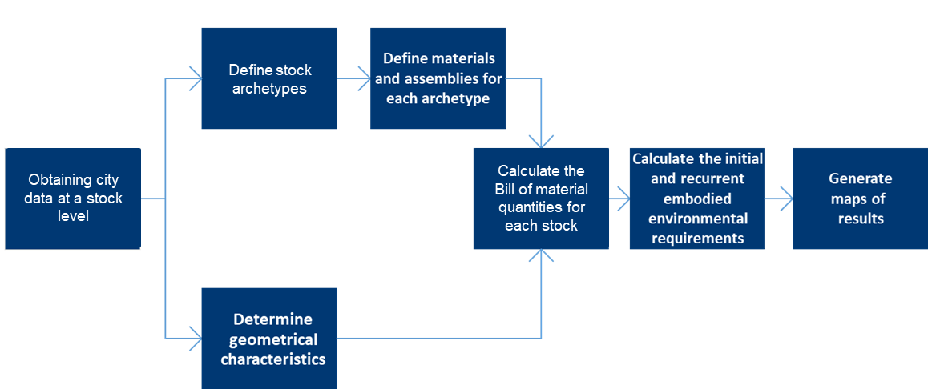
Exercise: Spatial allocation of materials (Bottom-up)
Félix Martin del Campo, Campfens, Léchot
Download datasets from moodle (zip files)
Decompress and load the “Grenada_***.shp” files into QGIS
Identify the type of geometry (point, line, polygon)
Notes:
Flow chart for all stocks types

Slide 6
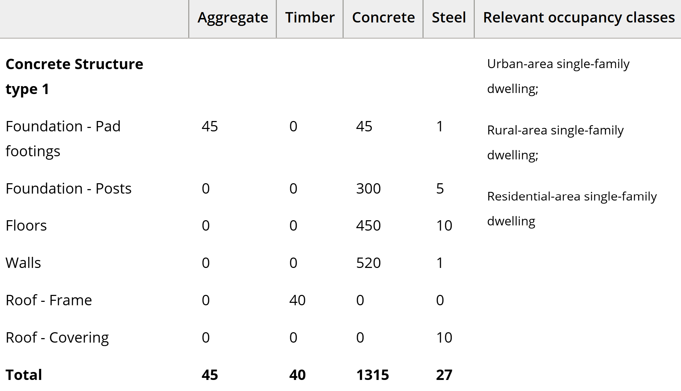
Exercise: Spatial allocation of materials (Bottom-up Residential buildings)
Félix Martin del Campo, Campfens, Léchot
TOTAL = 1,427 Kg/m2

Slide 7
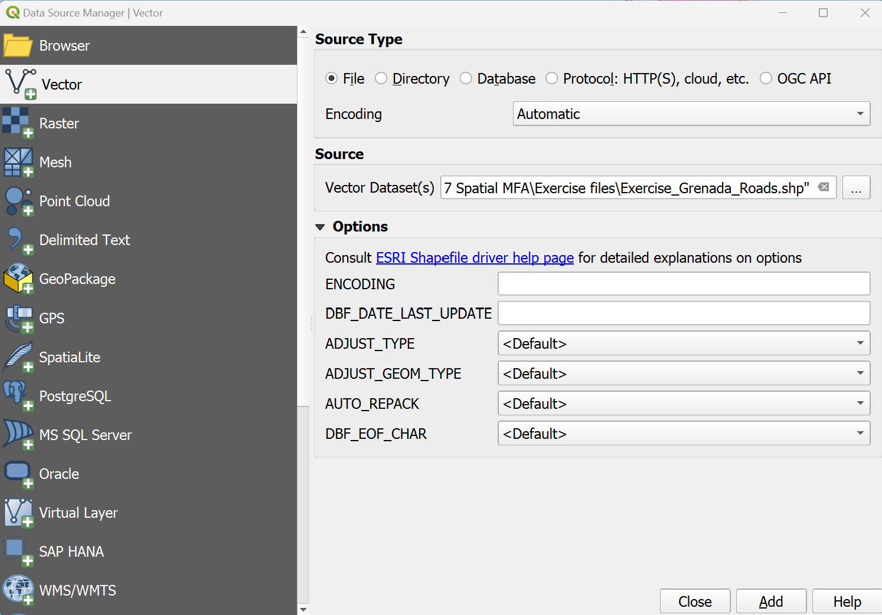
Layer – Add Layer – Add Vector Layer
Félix Martin del Campo, Campfens, Léchot

Slide 8
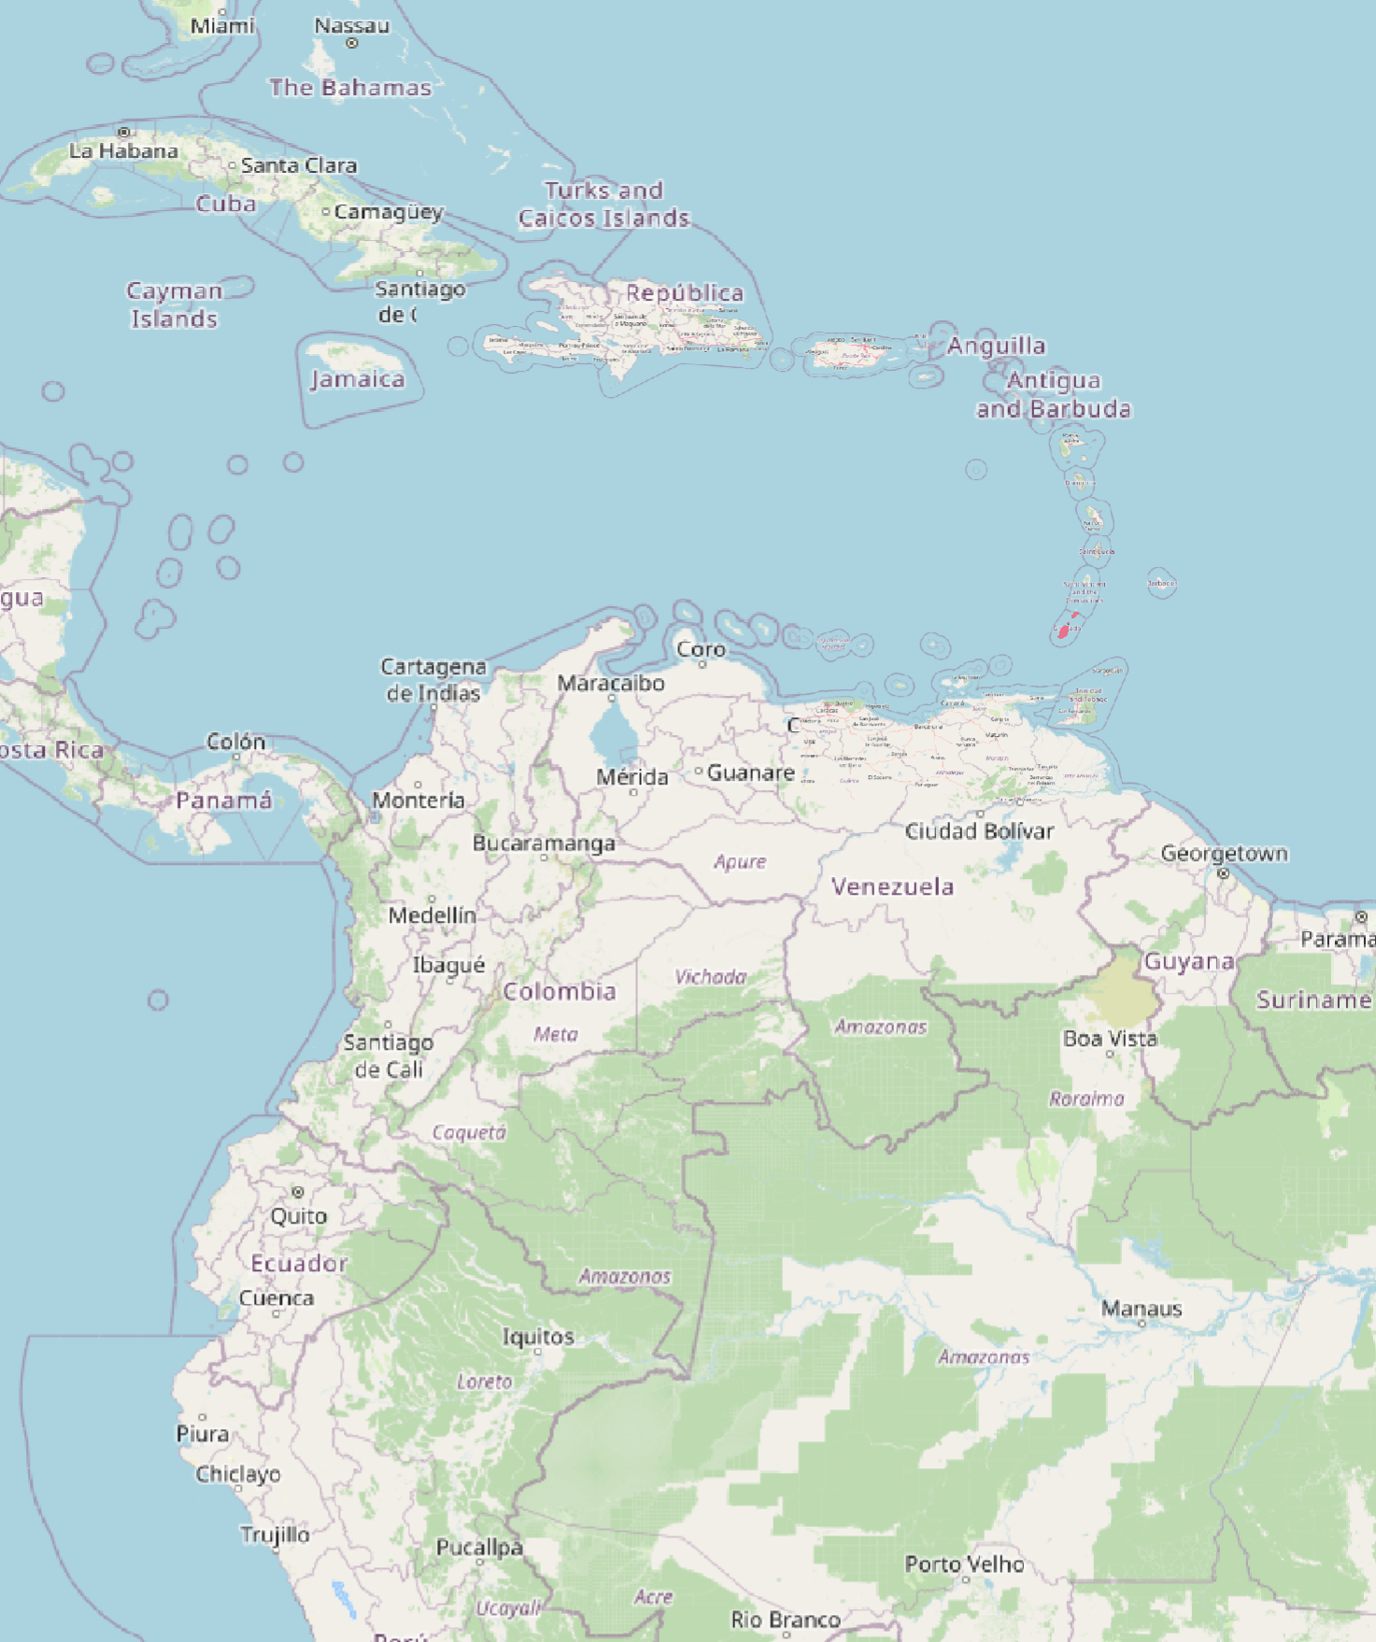
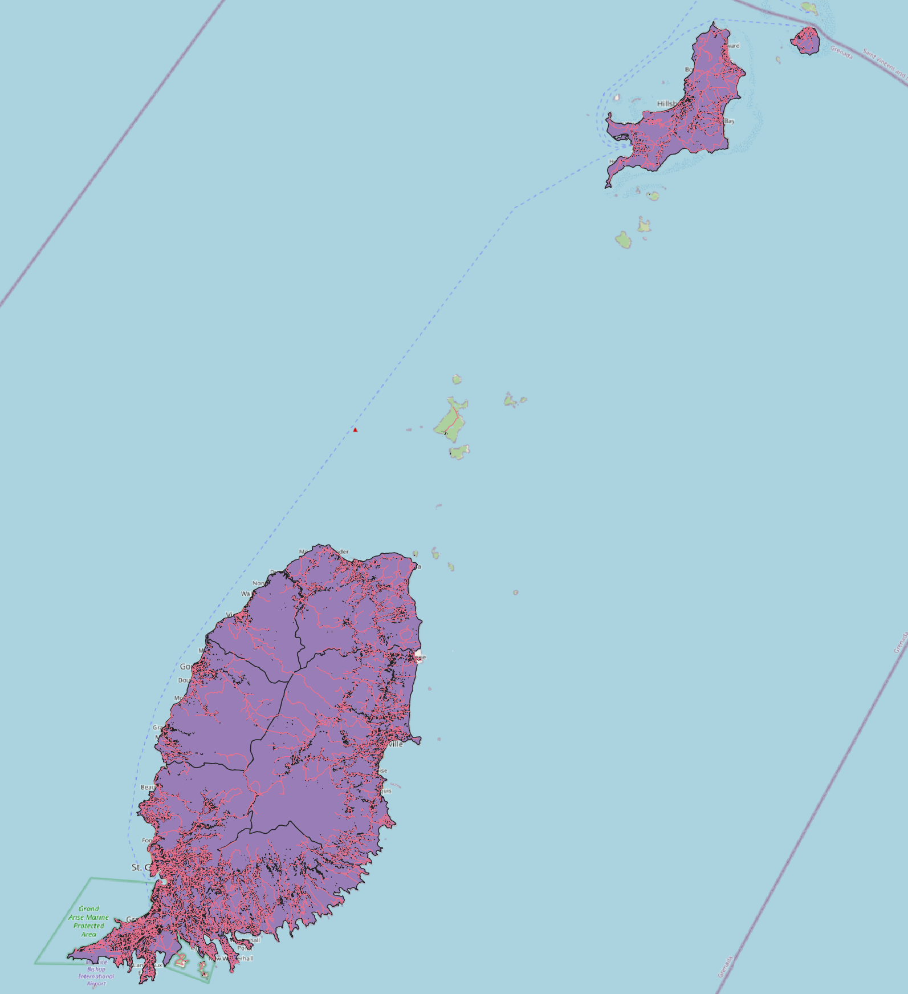
Félix Martin del Campo, Campfens, Léchot

Slide 9
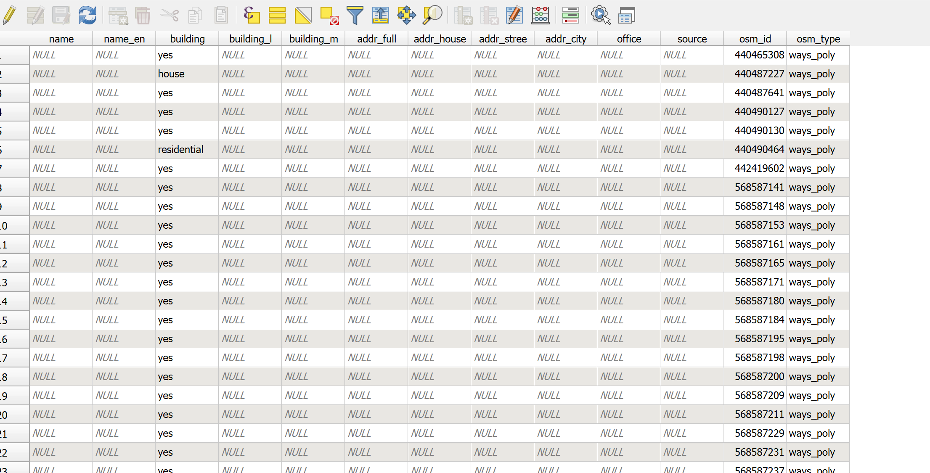
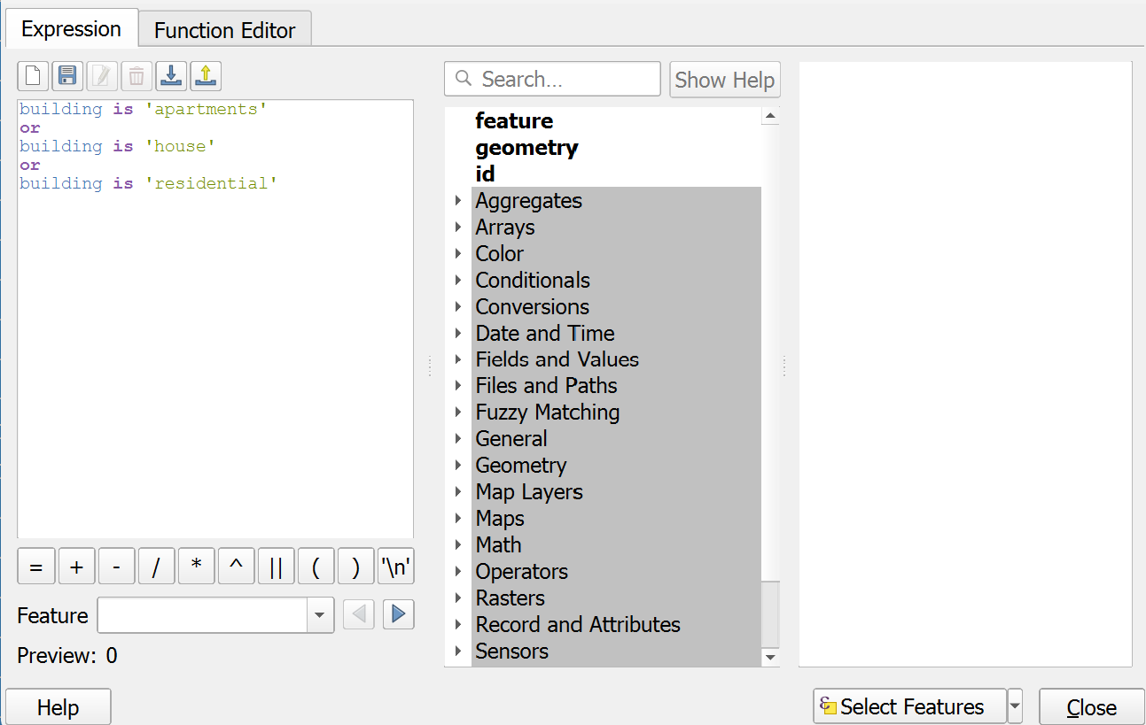
Select features using an expression
Félix Martin del Campo, Campfens, Léchot
Apartments
House
Residential

Slide 10
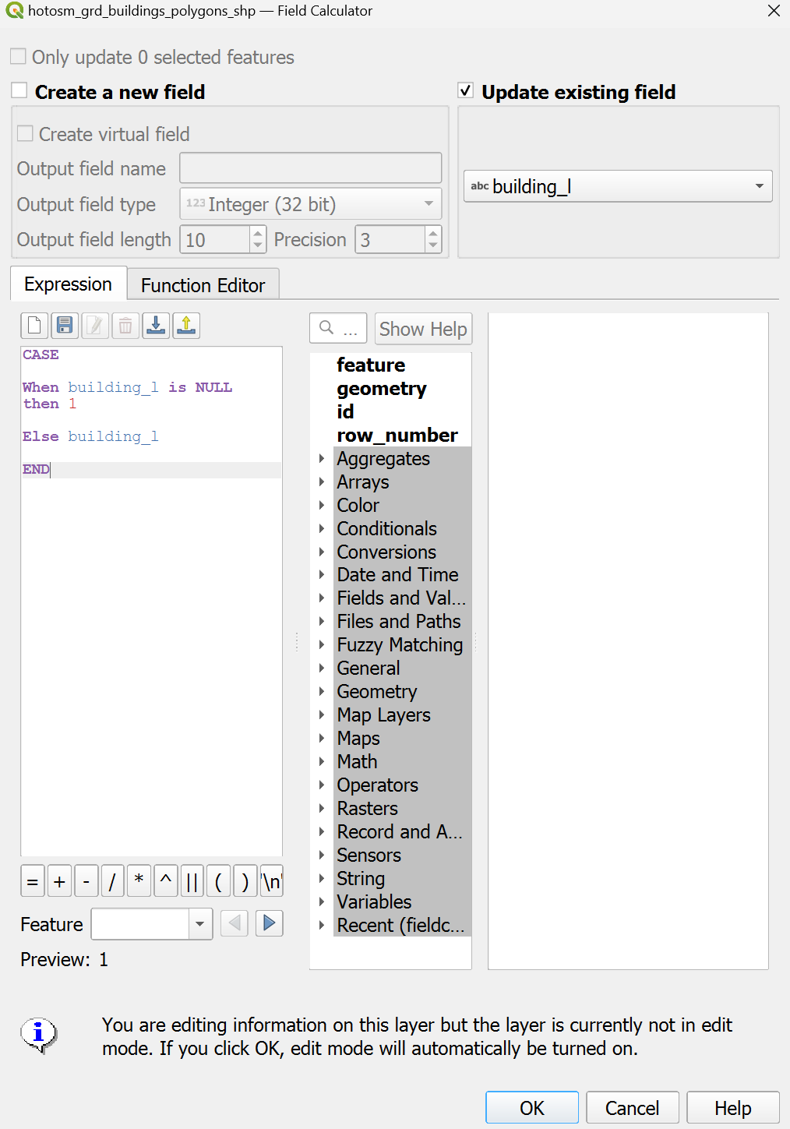
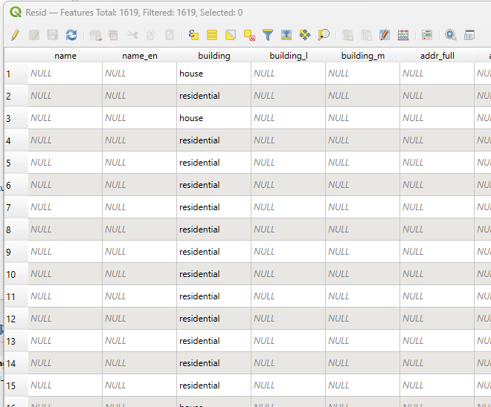
Field calculator
Félix Martin del Campo, Campfens, Léchot

Slide 11
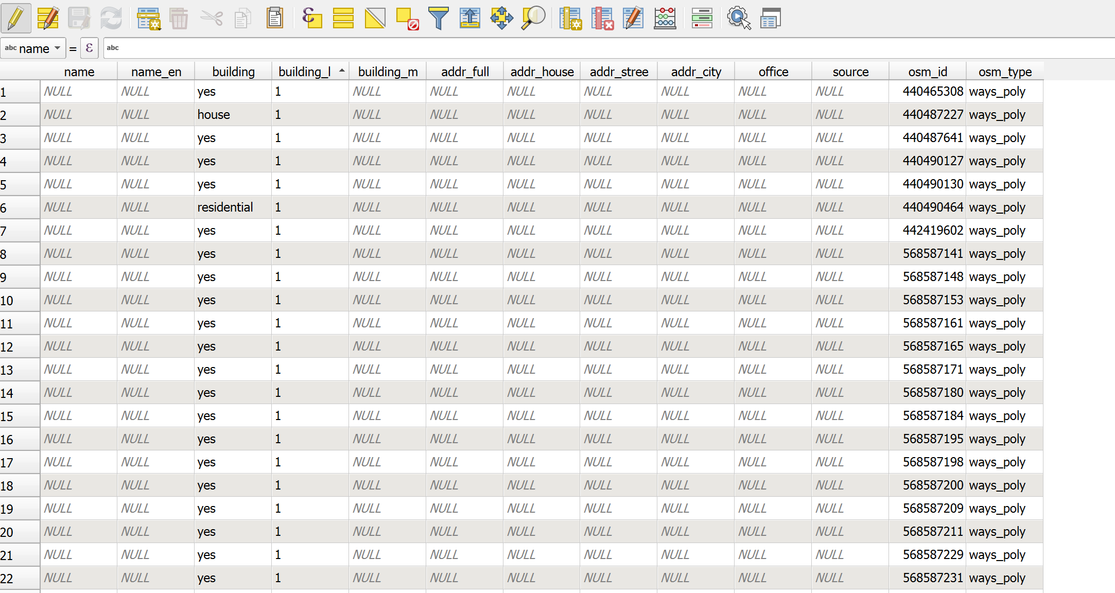
Félix Martin del Campo, Campfens, Léchot

Slide 12
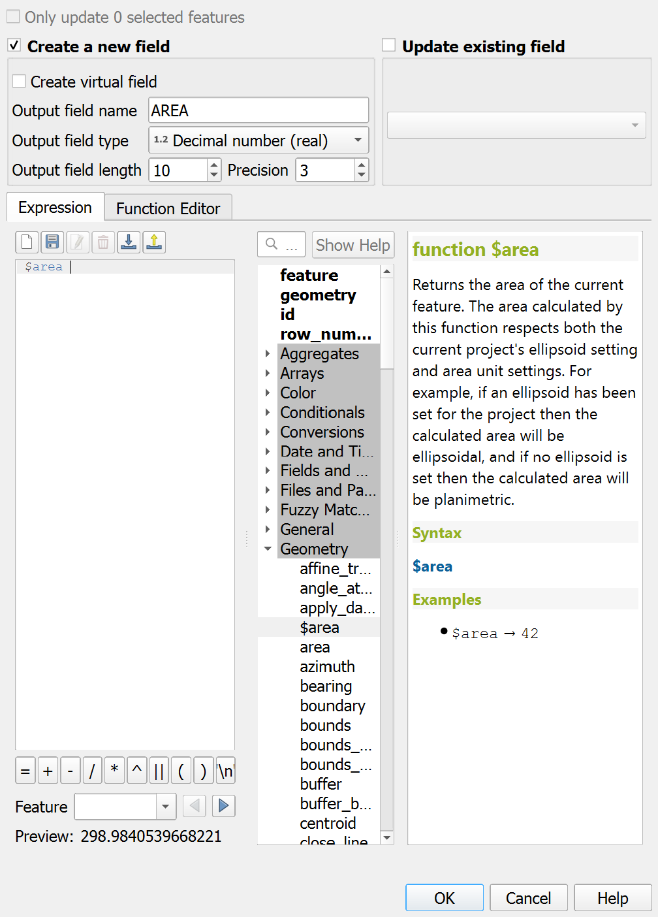
Félix Martin del Campo, Campfens, Léchot

Slide 13
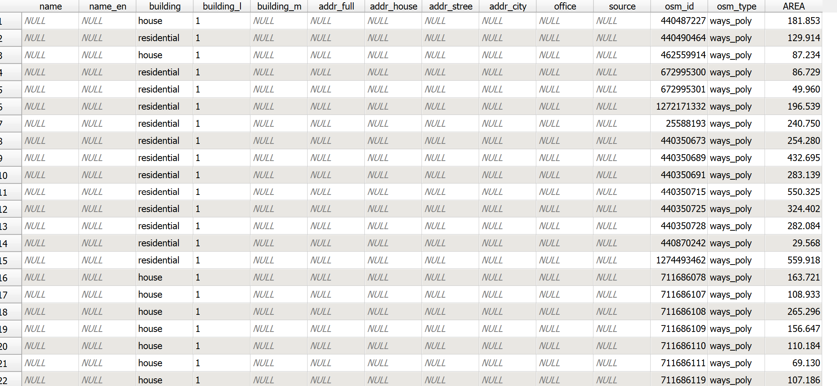
Félix Martin del Campo, Campfens, Léchot

